Slide 1
SQL for Data Querying and Analysis
Week 1

Slide 2
Agenda
Introduction
Course Overview and Structure
MySQL Workbench Overview
Why Should I learn SQL?
What are Relational Databases?
Let’s Code!

Slide 3
Introduction!
A little bit about myself…
Career (mention teaching before)
Outside of work
SQL usage

Slide 4
The course
Examples of topics that will be covered
Structure (classes and labs) (demos will correspond with classes)
How to succeed (spend time coding and manipulating code, use deck as reference on concepts only) (avoiding putting code in deck is my philosophy)
Office hours
MYSQL…

Slide 5
MySQL Workbench
Should have it installed by now!

Slide 6
Why should you learn SQL?
Universally used across industries!
Data analysts, scientists and engineers use it and so can you!
No more barriers between you and your data
Databases are interesting and worth having conversations with ;)
Beef this up!!!!

Slide 7
What is SQL?
SQL stands for Structured Querying Language
SQL is how we communicate with databases!
We can use SQL to pull, edit, or add information to a database
SQL is typed into a querying tool of your choice

Slide 8
What is SQL?
XXX

Slide 9
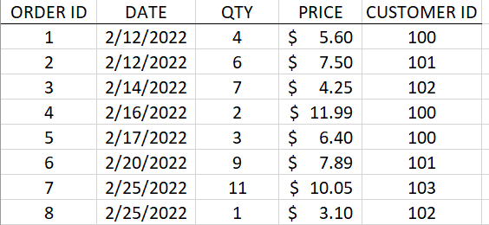
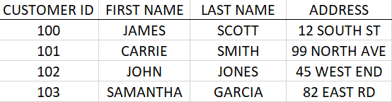
What are Relational Databases?
Relational databases store data in tables that are related to one another
They are key to understanding and writing effective SQL code!
Every row in every table has a unique key that identifies the row and can help relate the table to other tables in the database
Why not store data in a spreadsheet??
ORDERS TABLE
CUSTOMERS TABLE

Slide 10
Let’s Code!

Slide 11
Anatomy of a SQL Query
SELECT
COLUMN_1, SUM(COLUMN_2)
FROM
TABLE_NAME
WHERE
COLUMN_1 = ‘VALUE’
GROUP BY
COLUMN_1
HAVING
SUM(COLUMN_2) > 10
ORDER BY
COLUMN_1;
Notes:
6 clauses, not every query will have all 6
Only SELECT and FROM are required

Slide 12
Anatomy of a SQL Query
SELECT
COLUMN_1, SUM(COLUMN_2)
FROM
TABLE_NAME
WHERE
COLUMN_1 = ‘VALUE’
GROUP BY
COLUMN_1
HAVING
SUM(COLUMN_2) > 10
ORDER BY
COLUMN_1;
Select Clause
From Clause
Where Clause
Group By Clause
Having Clause
Order By Clause
Notes:
6 clauses, not every query will have all 6
Only SELECT and FROM are required
Order of clauses matters! – Can order by go before having?
Note the indentation – good syntax! (as queries get larger this becomes super important)

Slide 13
Anatomy of a SQL Query
SELECT
COLUMN_1, SUM(COLUMN_2)
FROM
TABLE_NAME
WHERE
COLUMN_1 = ‘VALUE’
GROUP BY
COLUMN_1
HAVING
SUM(COLUMN_2) > 10
ORDER BY
COLUMN_1;
Select Clause
The select clause determines which columns will be included in the query’s result

Slide 14
Anatomy of a SQL Query
SELECT
COLUMN_1, SUM(COLUMN_2)
FROM
TABLE_NAME
WHERE
COLUMN_1 = ‘VALUE’
GROUP BY
COLUMN_1
HAVING
SUM(COLUMN_2) > 10
ORDER BY
COLUMN_1;
From Clause
The from clause determines which tables to retrieve data from and how they should be joined

Slide 15
Anatomy of a SQL Query
SELECT
COLUMN_1, SUM(COLUMN_2)
FROM
TABLE_NAME
WHERE
COLUMN_1 = ‘VALUE’
GROUP BY
COLUMN_1
HAVING
SUM(COLUMN_2) > 10
ORDER BY
COLUMN_1;
Where Clause
The where clause filters out unwanted rows of data based on conditions

Slide 16
Anatomy of a SQL Query
SELECT
COLUMN_1, SUM(COLUMN_2)
FROM
TABLE_NAME
WHERE
COLUMN_1 = ‘VALUE’
GROUP BY
COLUMN_1
HAVING
SUM(COLUMN_2) > 10
ORDER BY
COLUMN_1;
The group by clause groups rows together by common column values
Group By Clause

Slide 17
Anatomy of a SQL Query
SELECT
COLUMN_1, SUM(COLUMN_2)
FROM
TABLE_NAME
WHERE
COLUMN_1 = ‘VALUE’
GROUP BY
COLUMN_1
HAVING
SUM(COLUMN_2) > 10
ORDER BY
COLUMN_1;
The having clause filters out unwanted groups based on conditions
Having Clause

Slide 18
Anatomy of a SQL Query
SELECT
COLUMN_1, SUM(COLUMN_2)
FROM
TABLE_NAME
WHERE
COLUMN_1 = ‘VALUE’
GROUP BY
COLUMN_1
HAVING
SUM(COLUMN_2) > 10
ORDER BY
COLUMN_1;
The order by clause sorts the output of the query by one or multiple columns
Order By Clause

Slide 19
Select Clause

Slide 20
Select Clause
The select clause determines which columns will be included in the query’s result
The select clause is one of two required clauses along with the from clause
Select clause can include column names, strings, expressions, function calls

Slide 21
Select Clause Uses
Retrieve every column in a table: SELECT *
Retrieve row count of a table: SELECT COUNT (*)
Create aliases (or labels) for a column in the query output: SELECT COLUMN AS First_Column
Retrieve unique values of a column: SELECT DISTINCT COLUMN
Notes:
Note these are not complete sql queries, only the select clauses from a query

Slide 22
Demo Set 1.1

Slide 23
From Clause

Slide 24
From Clause
The from clause determines which tables to retrieve data from and how they should be joined together
Tables can mean many things!
Permanent, temporary, derived, virtual tables (more on that later)
Tables are linked together with joins that leverage keys in each table (more on this later as well!)

Slide 25
Demo Set 1.2

Slide 26
Where Clause

Slide 27
Where Clause
The where clause filters out unwanted rows of data based on conditions
The where clause can include as many conditions as you want
Multiple conditions can be combined using parenthesis and AND/OR logic
Notes:
Mention

Slide 28
Where Clause Uses
Filter based on equality/inequality
Filter based on ranges
Equal to 20 | WHERE COLUMN = 20
Not equal to 20 | WHERE COLUMN <> 20
Less than or equal to 20 | WHERE COLUMN <= 20
Between 20 and 30 (inclusive) | WHERE COLUMN BETWEEN 20 AND 30

Slide 29
Where Clause Uses Cont.
Filter based on membership
Filter based on wildcards
Equal to A, B or C | WHERE COLUMN IN (‘A’, ‘B’, ‘C’)
Not equal to A, B, or C | WHERE COLUMN NOT IN (‘A’, ‘B’, ‘C’)
Begins with S | WHERE COLUMN LIKE ‘S%’
Does not end with S | WHERE COLUMN NOT LIKE ‘%s’
Contains substring ‘sas’ | WHERE COLUMN LIKE ‘%sas%’
Is a 3 letter string with b in the second position | WHERE COLUMN LIKE ‘_b_’
Notes:
Wildcards are case sensitive as they are wrapped in quotes
Consider

Slide 30
Where Clause Uses Cont.
Filter based on NULLs
Important to remember when dealing with nulls!
A value can be null but it cannot equal null
Two nulls are never equal to one another
IS NULL | WHERE COLUMN IS NULL
IS NOT NULL | WHERE COLUMN IS NOT NULL
Notes:
Wildcards are case sensitive as they are wrapped in quotes
Consider

Slide 31
Demo Set 1.3

Slide 32
Pop Quiz!

Slide 33
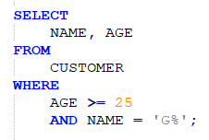
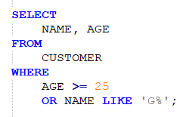
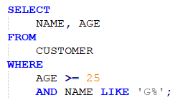
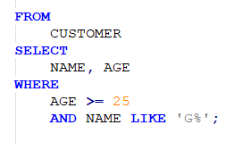
Which query retrieves the name and age columns from the CUSTOMER table of every customer that is at least 25 years old and whose name begins with G?
A)
B)
C)
D)

Slide 34
Which query retrieves the name and age columns from the CUSTOMER table of every customer that is at least 25 years old and whose name begins with G?
A)
B)
C)
D)

Slide 35
Group By Clause

Slide 36
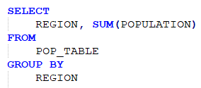
Group By Clause
In databases data is stored at the most granular level and so far we have only accessed data in its original and most granular form
The group by clause allows us to manipulate our data via grouping or aggregation across common column values
The group by clause is typically used with an aggregate function but does not need to be
Available Aggregate Functions: MAX(), MIN(), AVG(), SUM(), COUNT()
An aggregate function used without a group by aggregates entire dataset

Slide 37
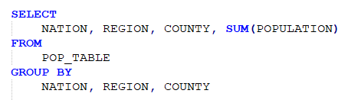
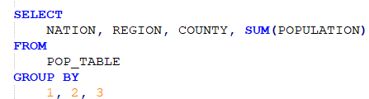
Grouping by Multiple Columns
Group by statements with multiple columns are necessary when aggregating across more than one column
Every column in select clause that is being aggregated across needs to be included in group by statement!
Numeric placeholders are excellent when grouping by more than 1 columns…

Slide 38
Group By
Keep this here but probs not necessary to cover…
Rollups?
How are nulls handled?

Slide 39
Demo Set 1.4
Just do a basic comparison with no group by, group by no agg, then group by with count

Slide 40
Having Clause

Slide 41
Having Clause
The having clause filters out unwanted groups based on conditions
While the where clause filters out unwanted rows the group by clause filters out unwanted groups after aggregation
Important distinction!
Queries can include both a where clause and a having clause

Slide 42
Demo Set 1.5

Slide 43
Pop Quiz!

Slide 44
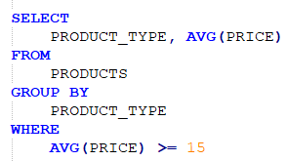
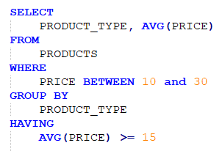
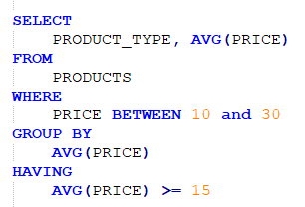
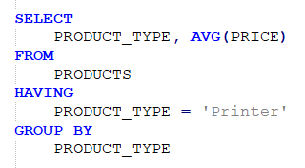
Which query runs successfully?
A)
B)
C)
D)
Notes:
A is wrong because where has the aggregate function
C is wrong because you are grouping by the aggregate function
D is wrong because having comes before group by (also makes no sense because filtering to one product type)

Slide 45
Which query runs successfully?
A)
B)
C)
D)
Notes:
A is wrong because where has the aggregate function
C is wrong because you are grouping by the aggregate function
D is wrong because having comes before group by (also makes no sense because filtering to one product type)

Slide 46
Order By Clause

Slide 47
Order By Clause
The order by clause sorts the output of the query by one or multiple columns
By default, the order by clause sorts in ascending order but can sort in descending order as well
Numeric placeholders also work great here!

Slide 48
Demo Set 1.6

Slide 49
Review!
XXX

Slide 50
Resources to Practice
Code Academy SQL Course: https://www.codecademy.com/learn/learn-sql
SQL Zoo: https://sqlzoo.net/
W3 Schools: https://www.w3schools.com/sql/sql_exercises.asp

Slide 51
Thank You!

Slide 52
Appendix

Slide 53
Functions
List functions here

